Slide 1
Principles of Data Science
Li Niu

Slide 2
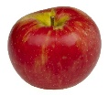
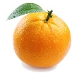

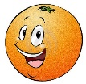


Domain generalization
Domain adaptation: unlabeled target domain is seen in the training stage.
mismatch
source domain
target domain
Domain generalization: unlabeled target domain is unseen in the training stage.
mismatch
?
source domain
target domain

Slide 3
Domain generalization
Domain adaptation: unlabeled target domain is seen in the training stage.
mismatch
source domain
target domain
Domain generalization: unlabeled target domain is unseen in the training stage.
mismatch
…
A or B or C
domain A
domain B
multiple latent domains
target domain

Slide 4
Domain generalization
Latent domain labels are known
Latent domain labels are unknown

Slide 5
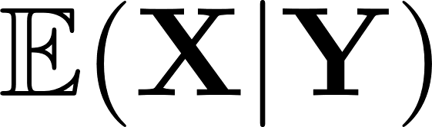
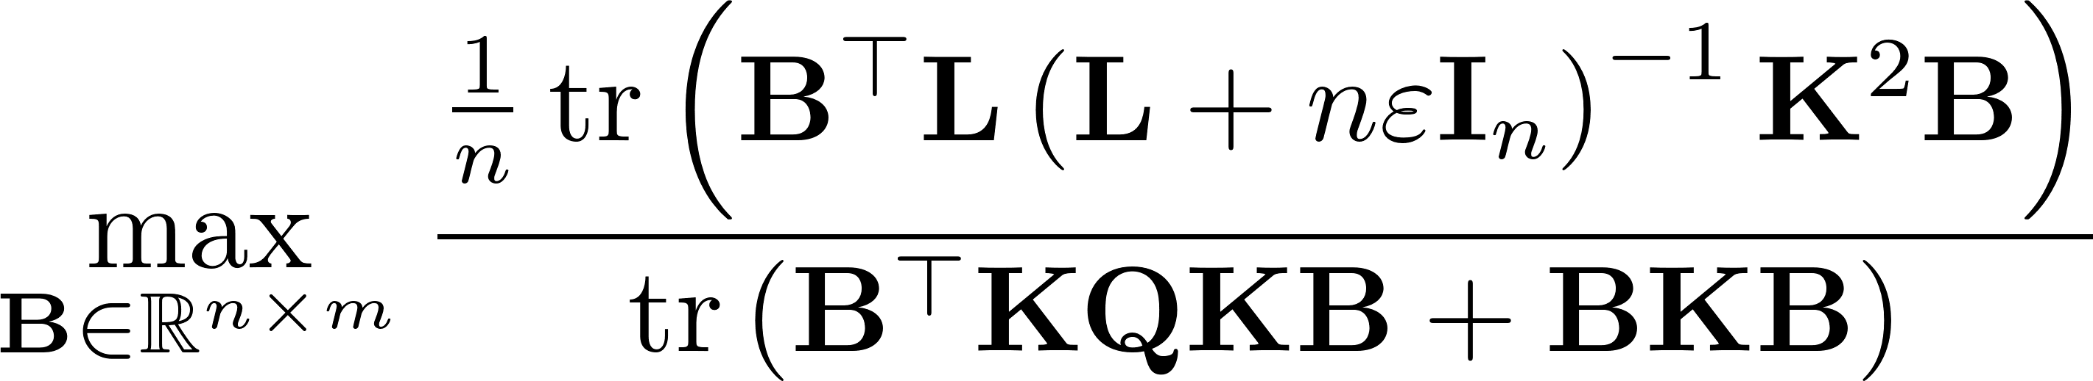



Domain-Invariant Component Analysis (DICA)
Muandet, Krikamol, David Balduzzi, and Bernhard Schölkopf. "Domain generalization via invariant feature representation." ICML, 2013.
Preserves the functional relationship
Minimize the difference across domains
After obtaining ,

Slide 6

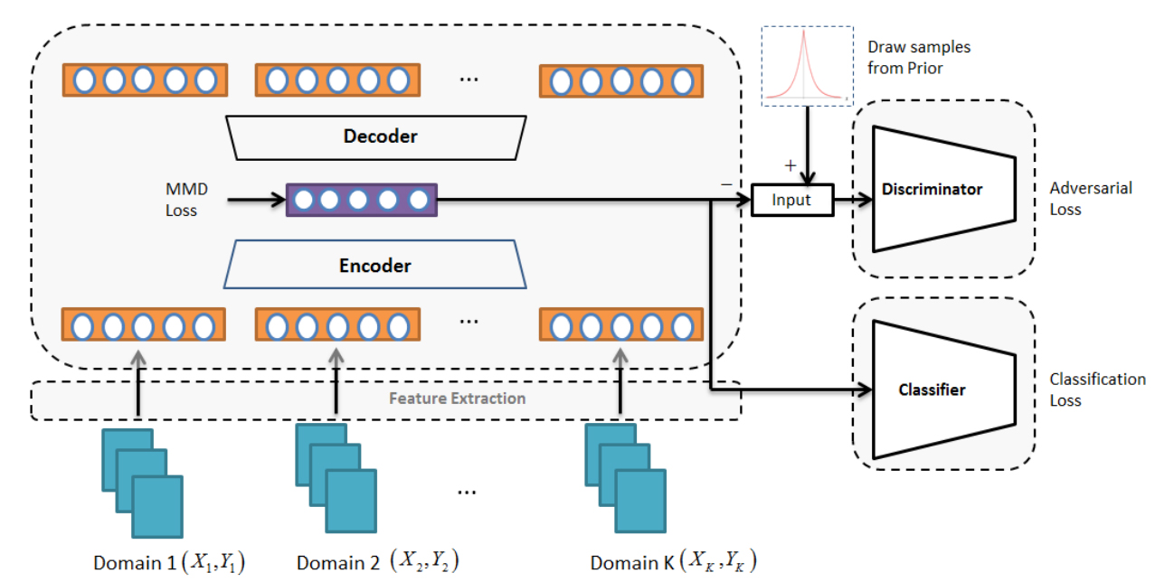
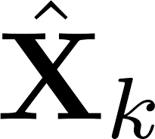


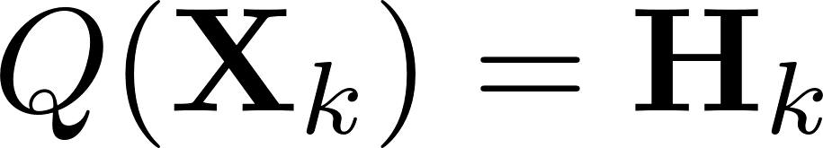

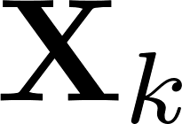
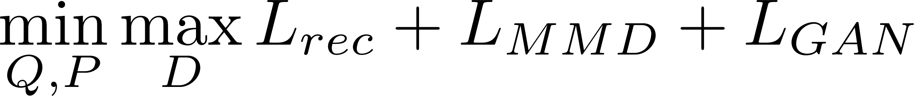
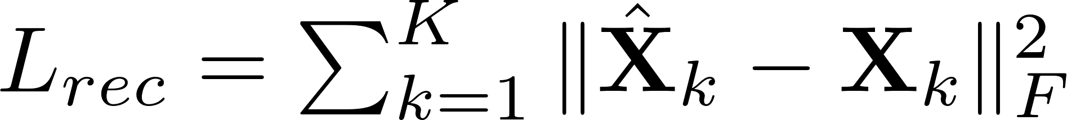
Li, Haoliang, et al. "Domain generalization with adversarial feature learning." CVPR, 2018.

Slide 7
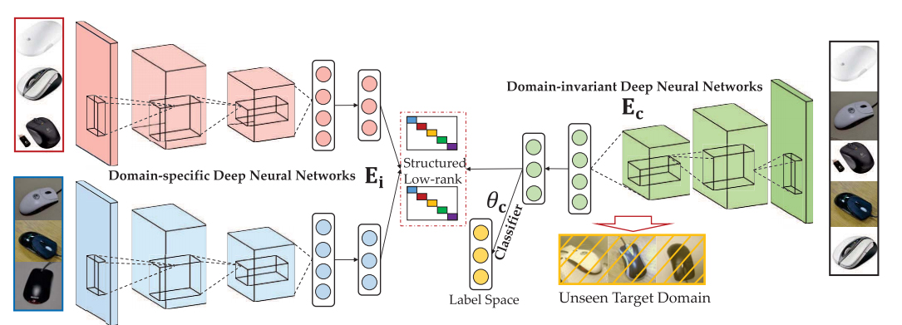
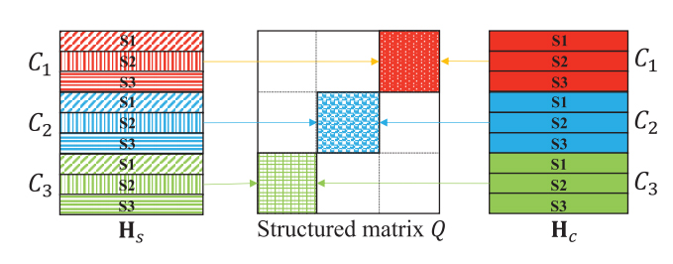
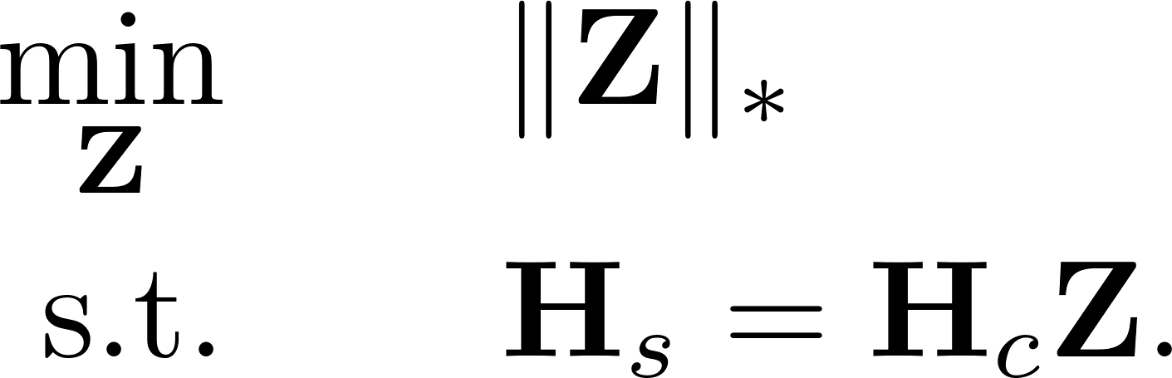
Ding, Zhengming, and Yun Fu. "Deep domain generalization with structured low-rank constraint." TIP, 27.1 (2018)
C: category S: domain

Slide 8
Domain generalization
Latent domain labels are known
Latent domain labels are unknown

Slide 9
When latent domain labels are unknown, discover multiple latent domains in the source domain.

Slide 10
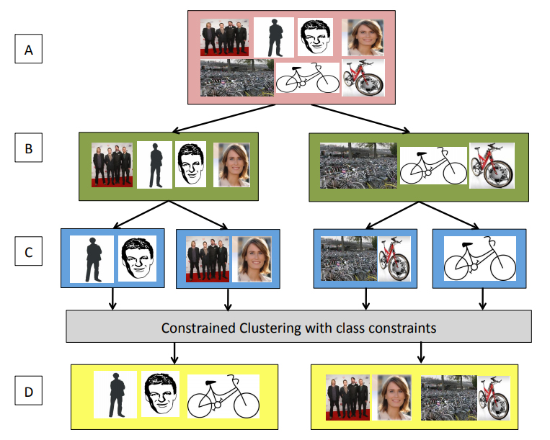
Hoffman, Judy, et al. "Discovering latent domains for multisource domain adaptation." ECCV, 2012.
If there are C categories and K domains, group training samples into C·K local clusters.
Cluster the means of the local clusters to find domains, in which each domain contains only a single local cluster from each category.

Slide 11



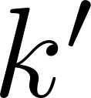
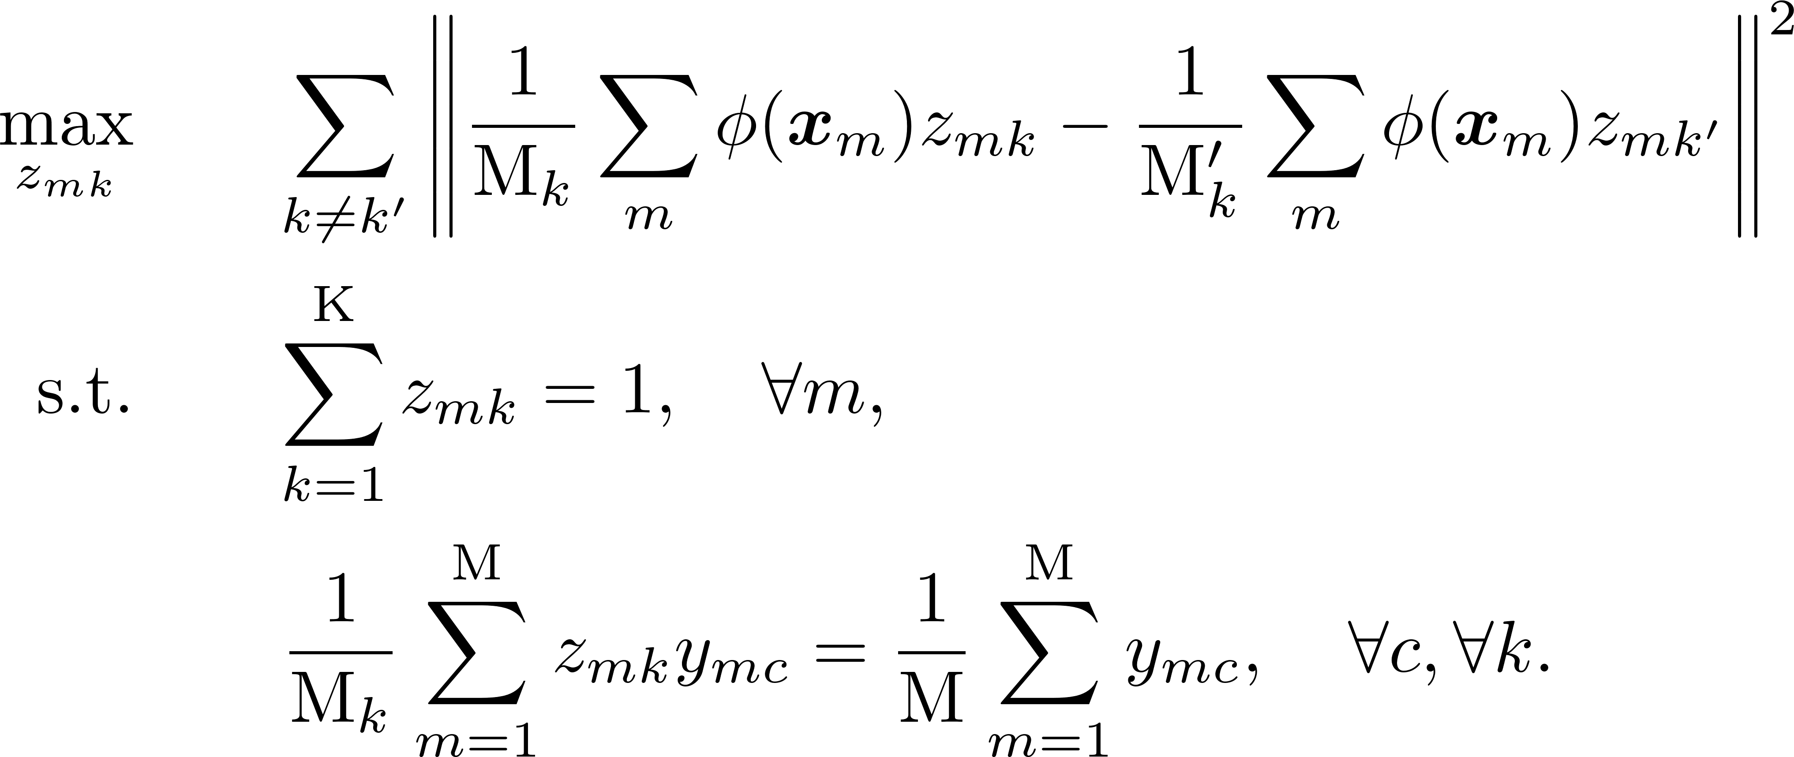
Gong, Boqing, Kristen Grauman, and Fei Sha. "Reshaping visual datasets for domain adaptation." NIPS, 2013.
: the probability that -th sample belongs to the -th latent domain
mean of -th latent domain
mean of -th latent domain

Slide 12
After determining latent domain labels, apply the methods with latent domain labels.

Slide 13
Thanks!

